Slide 1
LECTURE 2

Slide 2




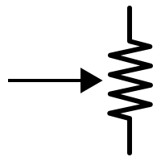
Magnetic field produced by current through a circular loop of conducting wire
N
P
Q
S
Give it a circular shape like a loop
Take a long conducting wire
Take a card board and make two holes.
Conclusion
R
Magnetic field ∝ Current
–
1
A
Magnetic field ∝
+
–
Radius
+

Slide 3
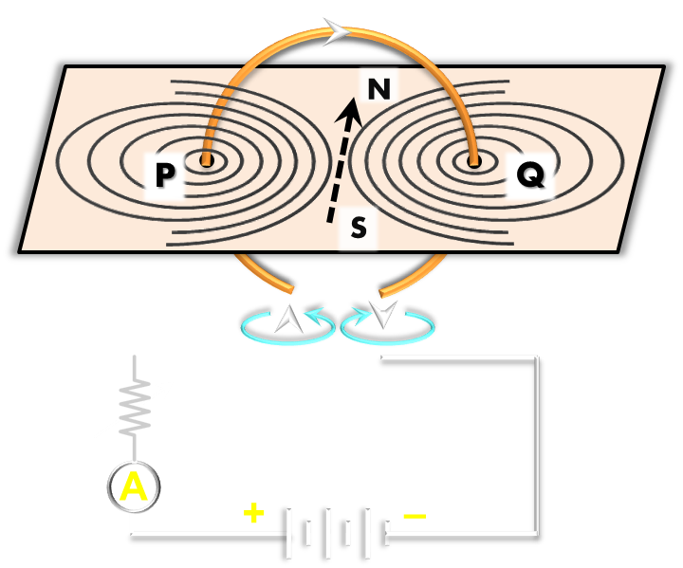

Magnetic field for different substances
Central field looks like a straight line.
N
S
Magnet field looks like a butterfly
Can I create the effect of bar magnet by passing current ?
Magnetic field for a circular coil
Straight conductor field is a concentric circles.
Magnetic field for
a straight conductor
Magnetic field is set of concentric circles at every point.

Slide 4

Magnetic field due to current through a CIRCULAR LOOP
The right hand rule helps to find the direction of magnetic field
Magnetic field is in the form of concentric circles
In the centre magnetic lines of force appear straight

Slide 5


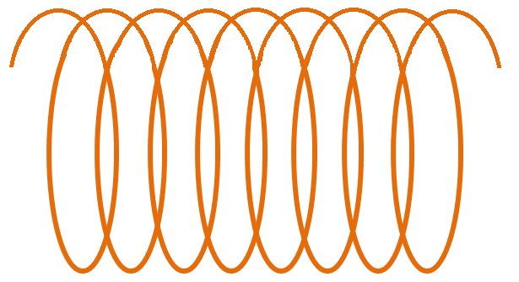


SOLENOID
A coil of many circular turns of insulated copper wire wrapped in the shape of a cylinder.
Magnetic field ∝ Current
Magnetic field ∝ No of turns
Magnetic field ∝ $\frac{\text{1}}{Radius of Coil}$
S
N
What does parallel lines of force inside the solenoid indicate ?
I
current
+
–
Ans: Intensity of the magnetic field within the solenoid is uniform everywhere, i.e. the magnetic field in a solenoid is uniform.
(
)
Key Open
Key closed
Electromagnets are temporary magnets

Slide 6


SOLENOID
Draw the coil freehand
Lets learn to draw a SOLENOID
S
N
Draw the lines of force
Draw 11 lines at distance of 1 or 2 mm
Erase the corners to bring uniformity
Connect to
a battery and plug key
+
–
(
)

Slide 7


What is a solenoid? Compare the magnetic field produced by a solenoid with the magnetic field of a bar magnet.
Ans :
1. When a copper wire with a resistive coating is wound in a chain of loops like a spring it is called solenoid.
2. When an electric current is passed through a solenoid magnetic field is produced in it.
3. The magnetic lines of force are similar to that of the lines of a bar magnet.
4. Solenoid has all properties of the field produced by a bar magnet.
5. One end of the coil acts as a south pole, while the other end as north pole.

Slide 8
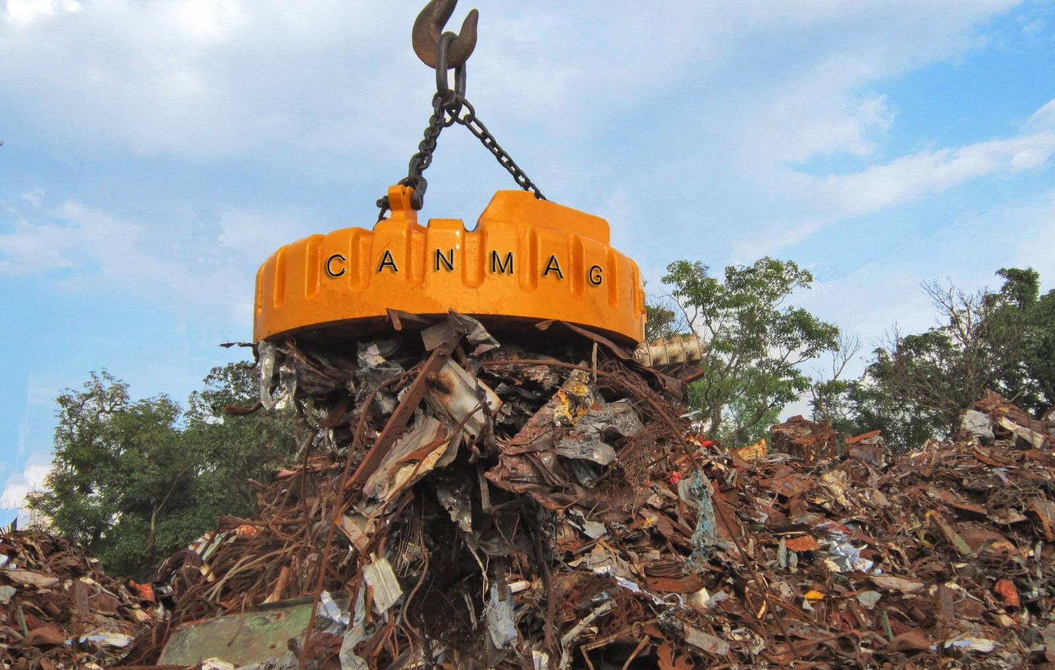

LIFTING
SCRAP IRON
APPLICATION OF
ELECTRO-MAGNETS
TEMPORARY
PERMANENT

Slide 9

SPEAKER
APPLICATION OF
ELECTRO-MAGNETS
TEMPORARY
PERMANENT

Slide 10
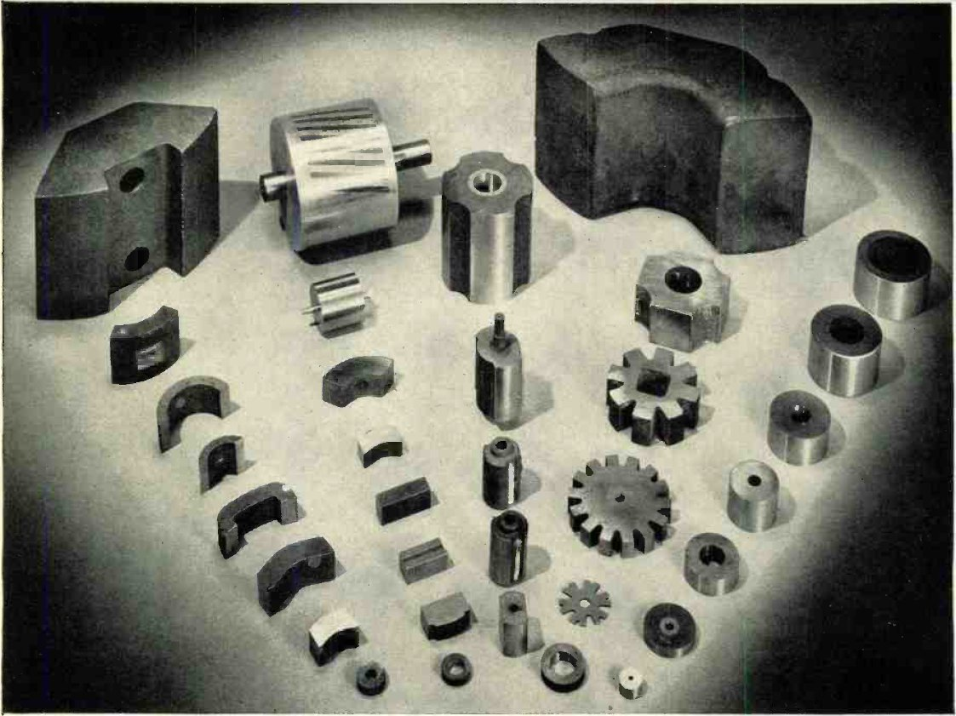
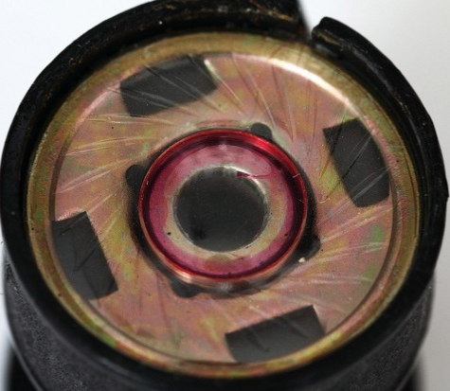
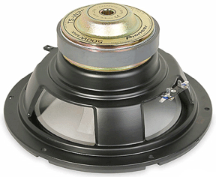
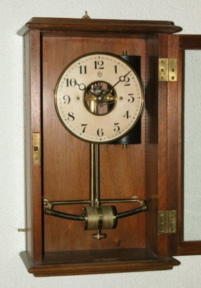
Nipermag, Alnico
Alloys like alnico or nipermag are used in industry
1. Alloys like alnico or nipermag are very hard and are used in the production of permanent magnets.
2. Nipermag is an alloy of iron, nickel aluminium and titanium. Alnico is aluminium, nickel – cobalt alloy.
3. Permanent magnet of such alloys are used in microphones, loudspeakers, electric clocks and many other devices like ammeter, voltmeter and speedometer.
Microphones
Loudspeakers
Electric clock

Slide 11
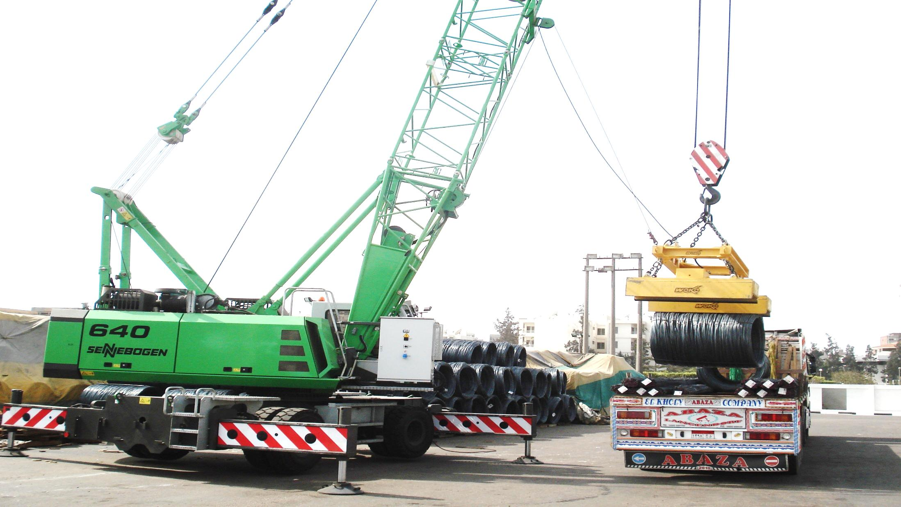
A magnetic crane is used to load and transport scrap iron
All scrap and loose iron material get attracted.
Magnetism is induced in the disc, as it is not feasible to create a permanent magnet of such a big size and store such a big magnet.
Hence magnetic crane is used to load and transport scrap iron.

Slide 12

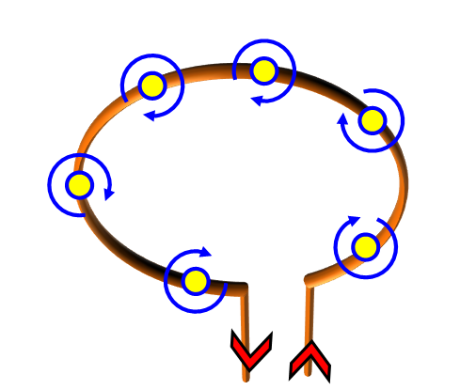

Consider a circular loop of wire lying in the plane of the table. Let the current pass through the loop clockwise. Apply the right-hand rule to find out the direction of the magnetic field inside and outside the loop.
Q.
Ans.
Each section of wire produces its concentric set of lines of force.
By applying right hand thumb rule, we find that all the sections produce magnetic field directed downward at all points inside the loop while at the outside points, the field is directed upwards.
Hence, the magnetic field acts normally into the plane of paper at the points inside the loop and normally out of the plane of paper at points outside the loop

Slide 13
Q.
The magnetic field in a given region is uniform. Draw a diagram to represent it.
Ans.
The uniform magnetic field B can be represented by equidistant parallel lines of force, as shown in Fig.
B

Slide 14
Choose the correct option :
The magnetic field inside a long straight solenoid-carrying current
(a) is zero;
(b) decreases as we move towards its end;
(c) increases as we move towards its end;
(d) is the same at all points.
Q.
Ans.
d. It is the same at all inside points.

Slide 15
Thank You

